Slide 1
Upstream
Preventing child sexual abuse

Slide 2
Welcome – and thank you for reading!
This presentation has been put together jointly by the Lucy Faithfull Foundation and the Alpha CSR Team
It is based on the Parents Protect! training programme that the Lucy Faithfull Foundation deliver online and in schools, to educate the public about preventing child sexual abuse
However, you do not need to be a parent to benefit
If you have children in your life that you love, or plan to in the future, then this course is for you

Slide 3
COURSE AIMS
RAISE AWARENESS OF SEXUAL ABUSE
What it is
What are the facts
What are the myths
Why it happens
How it happens

Slide 4
COURSE AIMS
EMPOWER PARENTS AND CARERS TO PROTECT CHILDREN
How to recognise signs of abuse in children
How to recognise signs of abuse in adults
How to teach children about personal safety
How to handle difficult conversations
Where to find further support

Slide 5
COURSE AIMS
More than anything, we aim to show you that child sexual abuse is
PREVENTABLE, NOT INEVITABLE
and give you the skills and knowledge you need to act

Slide 6
AIMS
So, let’s get started!

Slide 7
Upstream
PART 1: Myth Busting

Slide 8
1 – WHAT IS CHILD SEXUAL ABUSE?
Child sexual abuse can be:
… but also:
TOUCHING
Touching a child’s private parts for sexual pleasure
Making a child touch someone else’s private parts
Playing sexual games
Having sex
Putting objects or body parts (like fingers, tongue or penis) inside a child’s mouth, vagina or anus
NON-TOUCHING
Showing pornography to a child
Deliberately exposing an adult’s genitals to a child
Encouraging a child to watch sexual acts
Inappropriately watching a child undress or use the bathroom

Slide 9
1 – WHAT IS CHILD SEXUAL ABUSE?
In this course, we do not differentiate between types of sexual abuse
All types of abuse are serious and can risk significant harm to the child
Whilst some types of abuse (e.g. penetration) are more statistically likely to cause greater harm, the impact on an individual child encompasses many other factors, such as:
Support network
Age
Additional needs
Beliefs about self and others
Relationship to abuser
Use of force or grooming
Prior experiences of abuse
Duration of abuse
Experience of disclosure
Beliefs about abuse

Slide 10
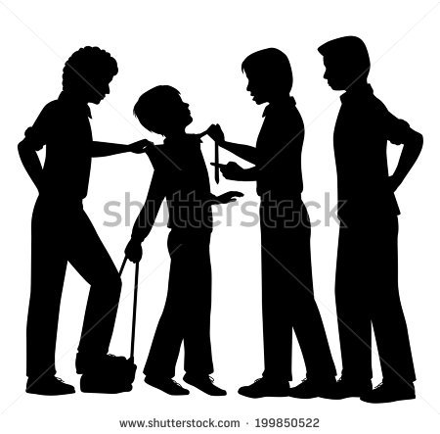
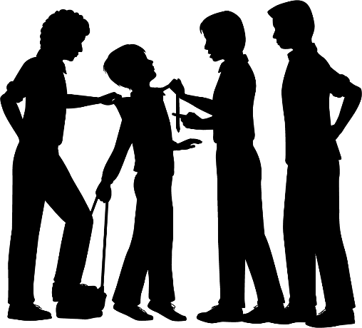
2 – PUTTING IT IN PERSPECTIVE
In terms of preventable harm, sexual abuse is just one of the many things we as parents may worry about
But, as with all risks, it is important to put it in perspective.
Looking at this list of common safety fears, where would you rate sexual abuse in terms of likelihood?
BULLYING
DROWNING
ANAPHYLAXIS
FRACTURES
SEXUAL ABUSE
ANIMAL BITES
TRAFFIC ACCIDENTS
BURNS
CHOKING

Slide 11
2 – PUTTING IT IN PERSPECTIVE
It may surprise you to learn that childhood sexual abuse is potentially more common than injury from all the following combined:
Pedestrian accidents
Cycling accidents
Vehicle collisions
Animal bites
Choking
Burns
Anaphylactic shock
Drowning
Relative size of objects represents the likelihood of harm before age 16
Sources: Pereda, Guilera, Forns, Gomez-Benito (2009); CDC Childhood Injury Report (2008); NICE - Allergy in the UK (2014).

Slide 12
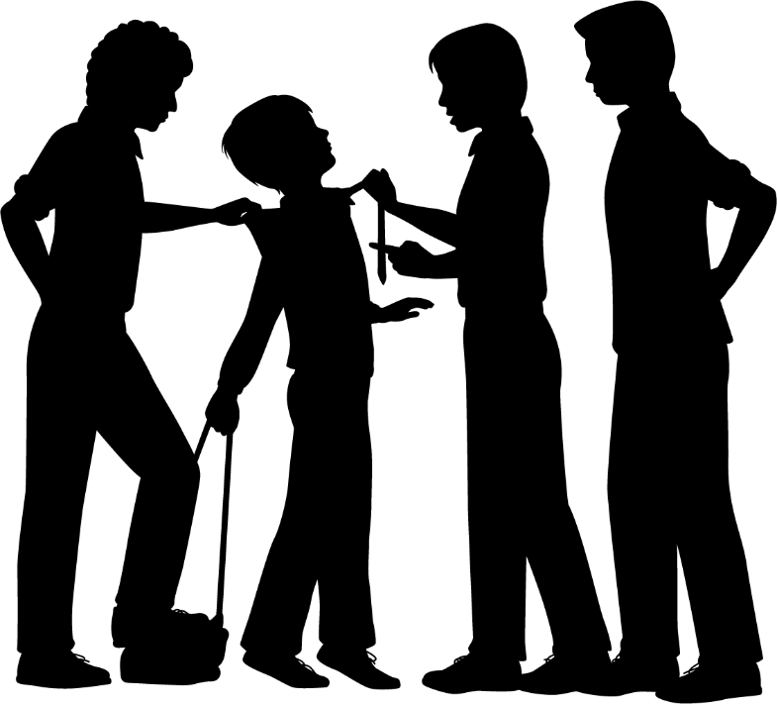
2 – PUTTING IT IN PERSPECTIVE
Or three times less likely than your child being bullied
In other terms, that is roughly half as likely as your child breaking a bone
Relative size of objects represents the likelihood of harm before age 16
Sources: Pereda, Guilera, Forns, Gomez-Benito (2009); CDC Childhood Injury Report (2008); NICE - Allergy in the UK (2014).

Slide 13
2 – PUTTING IT IN PERSPECTIVE
Even using the lowest estimates for sexual abuse, it is still on a par with the combined risks from all kinds of traffic accidents (pedestrian accidents, cycling accidents and vehicle collisions)
Relative size of objects represents the likelihood of harm before age 16
Sources: Pereda, Guilera, Forns, Gomez-Benito (2009); CDC Childhood Injury Report (2008); NICE - Allergy in the UK (2014).

Slide 14
2 – PUTTING IT IN PERSPECTIVE
To avoid traffic accidents, you may have taught your child:
How to cross the road safely
How to cycle safely
To always wear a seatbelt
Later in this course, we will look at similar preventative measures for child sexual abuse
Relative size of objects represents the likelihood of harm before age 16
Sources: Pereda, Guilera, Forns, Gomez-Benito (2009); CDC Childhood Injury Report (2008); NICE - Allergy in the UK (2014).

Slide 15
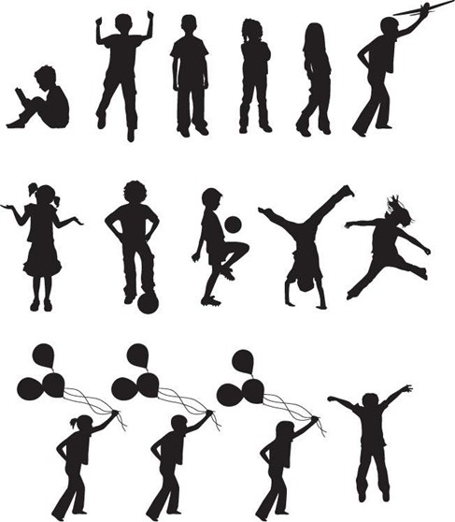
3 – HOW COMMON IS IT?
How many children in the UK experience sexual abuse before the age of 16?
Less than 1 in 20
More than 1 in 20
More than 1 in 5

Slide 16
3 – HOW COMMON IS IT?
Source: NSPCC: Child abuse and neglect in the UK today (2011)
Estimates vary, but recent studies by the NSPCC show that at least 1 in 20 children experiences some form of sexual abuse before the age of 16.
More than 1 in 20

Slide 17
3 – HOW COMMON IS IT?
Source: Pereda, Guilera, Forns, Gomez-Benito (2009)
However, other studies put the figure closer to 1 in 6 children and The Lucy Faithfull Foundation believe the figure is around 1 in 10 children.
It is hard to assess because many children do not disclose their abuse at the time.

Slide 18
4 – STRANGER DANGER
Stranger
Most of us teach our children to avoid strangers
You may have even been on the receiving end of this message yourself as a child
According to this message, if children avoid strangers, then they can significantly reduce their risk of harm
It is a popular message because it is simple – easy for children to understand and follow
Danger

Slide 19
4 – STRANGER DANGER
Stranger
Unfortunately, it is also wrong
Danger

Slide 20
4 – STRANGER DANGER
The stranger danger message is ineffective because it focuses on the least likely and least preventable type of abuse
Opportunistic attacks by strangers account for roughly 10-20% of all child sexual abuse
If your child is ever sexually abused, it is much more likely that they will be abused by a family member, a friend, a neighbour or a trusted professional
Later in this course, we will examine why this is, and how the stranger danger message can do more harm than good
Source: Pereda, Guilera, Forns, Gomez-Benito (2009)

Slide 21
5 – WILL MY CHILD TELL ME?
Given the scale of sexual abuse, we could reasonably expect to hear about it quite often – yet we don’t
Why is this?
One factor is that it can take children a long time to disclose abuse. If they are very young, they may not even recognise what it is
In two retrospective studies of adults, researchers looked at how long it took for people to disclose sexual abuse in childhood
Note: There is evidence to suggest that children are becoming more likely to disclose and report abuse, however, lack of disclosure remains a huge challenge for those studying child sexual abuse
Sources: Hebert et al (2009); Smith et al (2000)

Slide 22
5 – WILL MY CHILD TELL ME?
Measuring from the point the abuse occurred

Slide 23
5 – WILL MY CHILD TELL ME?
Only 27% disclosed their abuse immediately (within 1 year)

Slide 24
5 – WILL MY CHILD TELL ME?
A further 16% disclosed later in childhood (within 5 years)

Slide 25
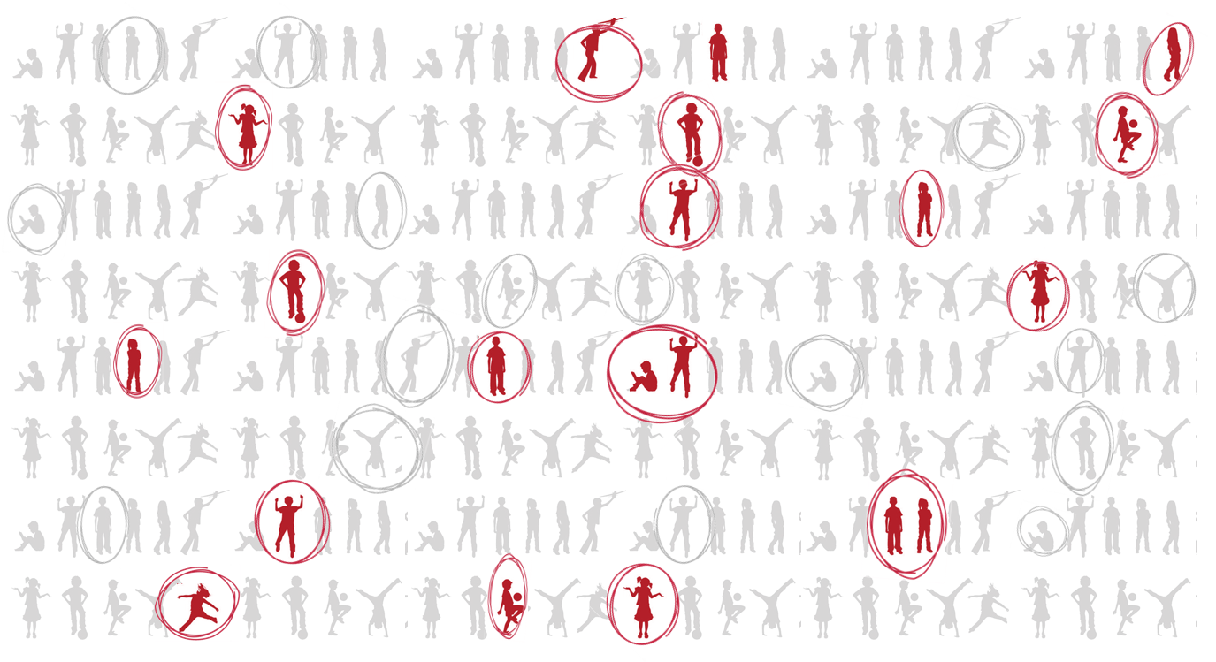
5 – WILL MY CHILD TELL ME?
However, the majority waited at least 5 years, often into adulthood

Slide 26
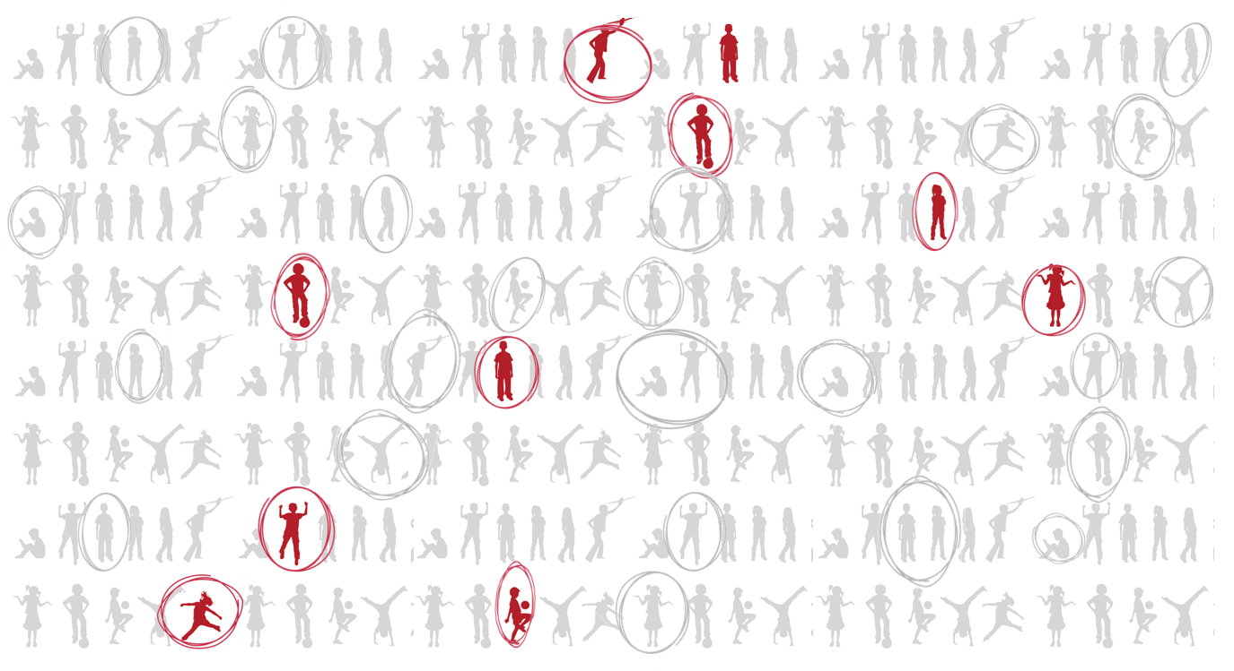
5 – WILL MY CHILD TELL ME?
When surveyed, 28% of the adults still had not told anyone

Slide 27
5 – WILL MY CHILD TELL ME?
Some may live their whole lives without ever disclosing

Slide 28
5 – WILL MY CHILD TELL ME?
It’s a private / family matter
I don’t have anyone to tell
There are many reasons why children may not tell anyone about their abuse
In a recent study, these were the top 10 reasons for not telling
Later in this course, we will look at the messages you can give to your children so that they know they can turn to you
I don’t think they will be sympathetic
I’m scared of more violence
I don’t want the police involved
It’s too humiliating
I don’t think they will do anything about it
They won’t believe me
I don’t want to go to court
It’s too trivial
Source: ONS, Abuse during childhood Findings from the Crime Survey for England and Wales, year ending March 2016

Slide 29
6 – WHAT ABOUT FALSE REPORTS?
Some people find it hard to know whether to trust a report of sexual abuse
Indeed, some claims of child sexual abuse are false
Knowingly making a false report to the police is rightly considered a criminal act in itself
It wastes valuable police time, undermines the credibility of genuine cases of abuse, as well as being damaging to those implicated in the falsified claims, including the child
So, how common is this problem?

Slide 30
6 – WHAT ABOUT FALSE REPORTS?
In a study of reported cases of child sexual abuse, around 5% of reported cases were later found to be false
This may actually seem quite high – although it is similar to false reporting rates for other types of crime
Crucially, though, these false reports were usually made by adults in custody disputes and by older adolescents – not by children
Source: False Allegations of Sexual Abuse by Children and Adolescents (1989) - Everson M, Boat B

Slide 31
6 – WHAT ABOUT FALSE REPORTS?
In the context of cases that are not reported, the picture of false reports looks quite different
Because sexual offences are frequently under-reported, there are likely to be many cases that are never brought to the police
For every case that is falsely reported, there may be dozens more that are not reported at all.
Note: There are huge challenges in collecting accurate and timely data – disclosure is often delayed by several years, definitions of abuse vary, and behaviour around disclosure and reporting is changing over time
Sources:
False Allegations of Sexual Abuse by Children and Adolescents (1989) - Everson & Boat;
“38,000 offences reported per year; 1 in 20 children abused during childhood.” NSPCC - How safe are our children? (2017);
“1 in 6 children abused in childhood” Pereda, Guilera, Forns, Gomez-Benito (2009);
“12% of offences reported” - Hanson, Resnick, Saunders, Kilpatrick & Best (1999)
Unreported cases (upper estimate)
Unreported cases (lower estimate)
Reports
265,000 per year
90,000 per year
38,000 per year

Slide 32
7 – WHAT IS THE IMPACT?
x 4
Although sexual abuse rarely results in physical injury, the
psychological effects can be serious and long-lasting
Child sexual abuse is a significant risk factor for several psychiatric disorders and other adverse life outcomes
x 5
In Adulthood
Abuse
Anxiety
Disorders
x 4
Disorders
Eating
x 10
more likely
Behaviour
Suicidal
x 3
Abuse
Substance
x 3
x 3
PTSD
Depression
x 2
Away
Running
x 2
Pregnancy
Teen
Sources: Suicide risk following child sexual abuse. (2001); Darkness To Light child sexual abuse statistics (2015)
Likelihood for child sexual abuse survivors compared to general population (approximation using several sources and methodologies)

Slide 33
7 – WHAT IS THE IMPACT?
Sexual abuse, in adulthood or in childhood, has a strong link with suicidal thoughts and behaviour, including suicide attempts
23.5%
% of people who have attempted suicide in their lifetime
4.4%
5.3 x increase
Population average
Those with a history of sexual abuse*
* Includes all kinds of sexual abuse; the rates for childhood abuse may be higher
Source: Non-fatal suicidal behaviour among adults aged 16 to 74 in Great Britain (ONS, 2000)

Slide 34
7 – WHAT IS THE IMPACT?
4.4%
4.5%
6.8%
Average
Bereaved
Or Job Loss
8.8%
Redundancy
Or Divorce
9.5%
Separation
10.5%
For 1+ Months
Unemployed
Bullied
10.5%
Being
Crisis
Financial
16.8%
With The Law
In Trouble
In fact, the link may be stronger than for almost all other kinds of adverse life event
20.3%
From School
Expelled
20.5%
Violence
23.5%
Domestic
Abuse
Sexual
Source: Non-fatal suicidal behaviour among adults aged 16 to 74 in Great Britain (ONS, 2000)

Slide 35
7 – WHAT IS THE IMPACT?
4.4%
Average
Except for homelessness and running away from home
24.5%
23.5%
26.0%
Abuse
Homeless
Sexual
Home
Being
Fleeing
Source: Non-fatal suicidal behaviour among adults aged 16 to 74 in Great Britain (ONS, 2000)

Slide 36
7 – WHAT IS THE IMPACT?
Another particularly sad phenomenon is revictimisation – survivors of abuse are at a much higher risk of experiencing it again
For example, those who have experienced childhood rape or sexual assault by penetration, are much likelier than the general population to experience it again in adulthood

Slide 37
7 – WHAT IS THE IMPACT?
Another particularly sad phenomenon is revictimisation – survivors of abuse are at a much higher risk of experiencing it again
For example, those who have experienced childhood rape or sexual assault by penetration, are much likelier than the general population to experience it again in adulthood
26.7%
Female survivors are 4.5 times likelier to be victimised as adults, compared to the general population
6.0%
Women also abused as children
All women
Source: ONS, Abuse during childhood Findings from the Crime Survey for England and Wales, year ending March 2016

Slide 38
7 – WHAT IS THE IMPACT?
Another particularly sad phenomenon is revictimisation – survivors of abuse are at a much higher risk of experiencing it again
For example, those who have experienced childhood rape or sexual assault by penetration, are much likelier than the general population to experience it again in adulthood
3.8%
0.5%
For males, the likelihood of adult victimisation is 7.3 times greater
Men also abused as children
All men
Source: ONS, Abuse during childhood Findings from the Crime Survey for England and Wales, year ending March 2016

